Slide 1

The Battle of Neighborhoods North York
Data science
Capstone
IBM & Coursera
2021

Slide 2

Introduction
The goal of this project is to help people explore the best places in their neighborhood. This will help them to make smart and efficient decisions about choosing a good neighborhood among other neighborhoods in North York, Toronto.
This project aims to create an analysis of the characteristics for a people migrating to North York to find a better neighborhood as a comparative analysis between neighborhoods. Features include the median housing price and better school according to ratings

Slide 3
Problem
The main goal of this project is to suggest a better neighborhood in a new city for the person who moves there. Social presence in society in terms of like-minded people. Connectivity to airport, bus stop, city center, markets and other daily needs nearby.
1. Sorted list of house in terms of housing prices in a ascending or descending order
2. Sorted list of schools in terms of location, fees, rating and reviews

Slide 4
Location
North York is one of the six administrative districts of Toronto, Ontario, Canada. it was one of the fastest-growing parts of the region due to its proximity to Old Toronto.
In 1998, North York was amalgamated with the rest of Metropolitan Toronto to form the new city of Toronto and has since been a secondary economic hub of the city outside Downtown Toronto.

Slide 5

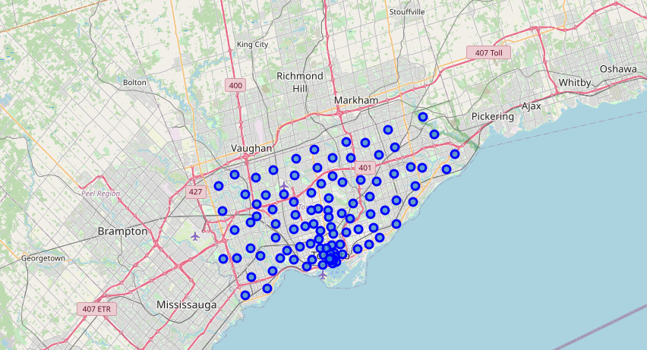
Map of North York, Toronto

Slide 6
Data Description
Data Link:
https://en.wikipedia.org/wiki/List_of_postal_codes_of_Canada:_M
Will use North York dataset which we scrapped from wikipedia on Week 3. Dataset consisting of latitude and longitude, zip codes.

Slide 7
Foursquare API
We will need data about different venues in different neighborhoods of that specific borough.
In order to gain that information we will use "Foursquare" locational information.
As such, the foursquare location platform will be used as the sole data source since all the stated required information can be obtained through the API.
After finding the list of neighborhoods, we then connect to the Foursquare API to gather information about venues inside each and every neighborhood. For each neighborhood, we have chosen the radius to be 100 meter.

Slide 8

Methodology & Results
Clustering Approach:
To compare the similarities of two cities, we decided to explore neighborhoods, segment them, and group them into clusters to find similar neighborhoods in a big city like New York and Toronto. To be able to do that, we need to cluster data which is a form of unsupervised machine learning: k-means clustering algorithm

Slide 9
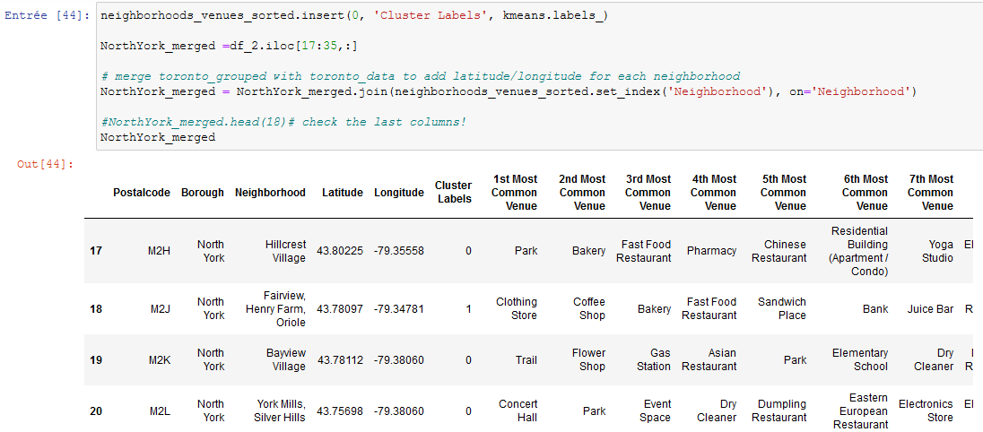
Using K-Means Clustering Approach

Slide 10
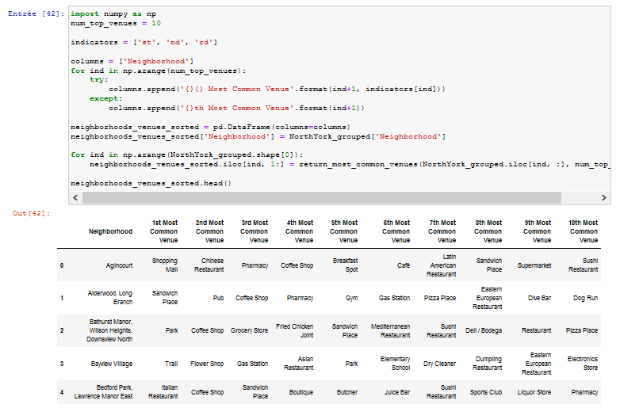
Most Common Venues

Slide 11
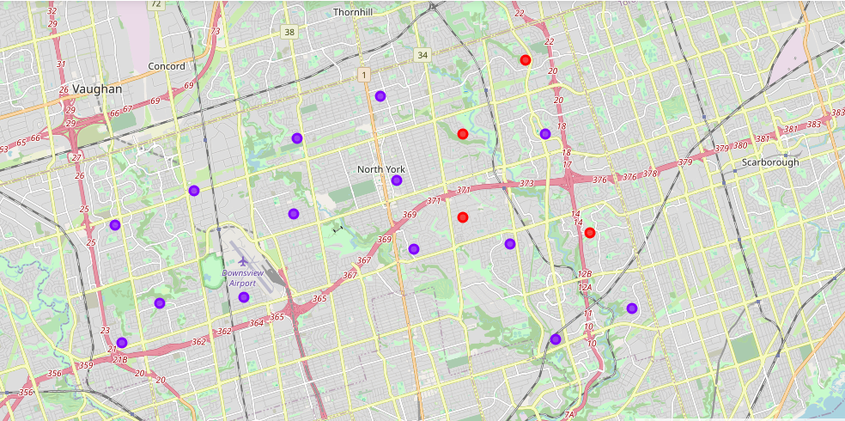
Map of Clusters in North York

Slide 12
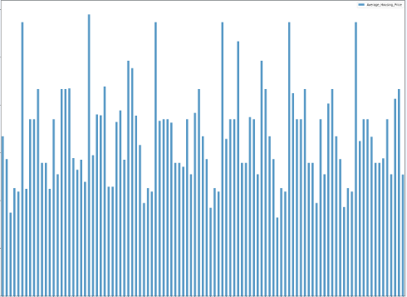
Average Housing Price

Slide 13
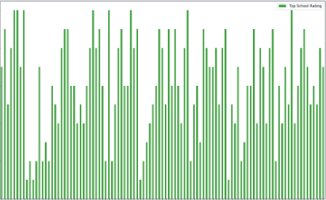
School Rating

Slide 14
Conclusion
In this project, using the k-means cluster algorithm, I split the neighborhood into 10 (ten) different clusters and for 103 different latitudes and longitudes of the dataset, which have very neighborhoods. similar around them. Using the graphs above, the results presented to a particular neighborhood based on the average house prices and the school rating were obtained.

Slide 15

Thanks!
IBM Data Science Professional Certificate

